Slide 1
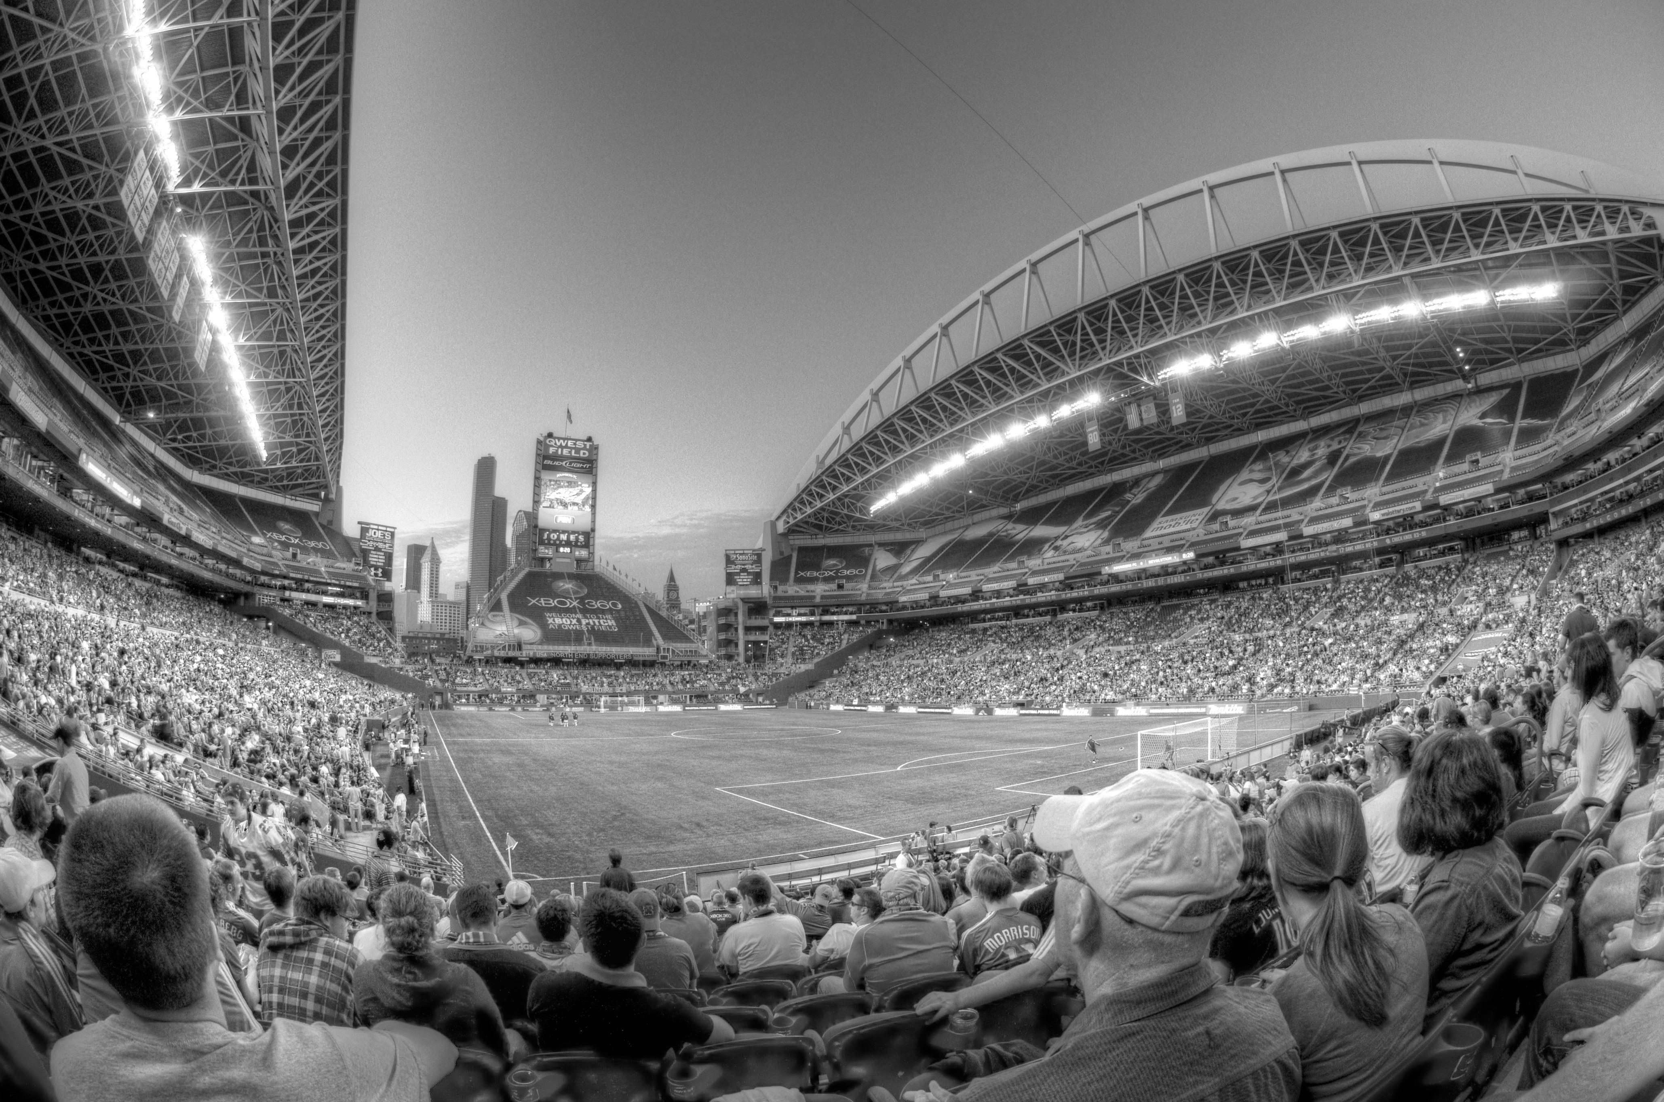
Shootout
I Called it!
Nick Capaldini, Saurav Kharb, Lester Herrera, Julian Narvaez

Slide 2

Design
Enter Prediction!

Slide 3
Design

Slide 4
Design

Slide 5
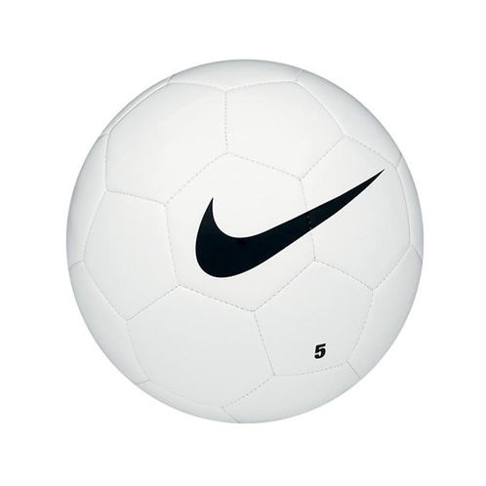
Design
Prediction Accuracy: 80%

Slide 6
Demo

Slide 7
Business

Slide 8
Go To Market Strategy

Slide 9
Questions?
Shootout
I Called it!

